Slide 1
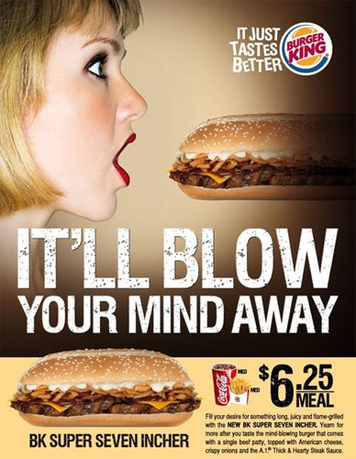
Burger
King

Slide 2
Singapore
2010

Slide 3
Sexual
Suggestion

Slide 4
Using
Female

Slide 5
Target:
18-24 male

Slide 6
Reference
https://www.qualitylogoproducts.com/blog/12-offensive-advertisements/

